Slide 1


Author: Dominique Grimes
Date: May 20, 2024
Data Solutioning for
Bank Fraud Detection
z
Notes:
The ability to ingest data quickly and efficiently is crucial for any business looking to stay competitive in today's digital economy.

Slide 2
Challenges
Problem
Statement
  Evolving fraud techniques
  Data Volume & Complexity
  False Positives
  Regulatory Compliance
  Legacy system integration
  Cybersecurity Threats
  Customer Behavior Analysis
  Resource Constraints
  Coordination & Information Sharing
  Technological Advances
As a leading global bank
we need the the ability
to optimize fraud detection
so that our clients are protected
and adverse risk is minimized.
Solution Objectives
Real-time detection of potentially fraudulent transact-ions, alerting the user and bank authorities instantly.
1
Analysis of user behavior to identify unusual patterns or anomalies.
2
Automatic blocking of transact-ions based on certain high-risk factors.
3
Offering security notifications to users based on their transaction behavior and locations.
4
Ensure compliance with global banking regulations regarding money laundering and fraud detection.
5

Slide 3


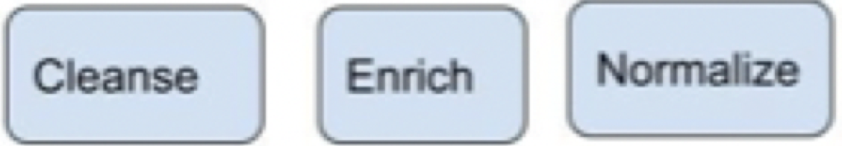


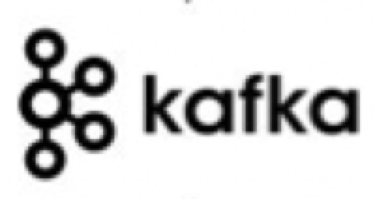





ARCHITECTURE
(High-level)
Multi-Source
(APIs, File Systems, Databases, etc.)
Pre-Processing
& Ingestion
Processing & Analysis
Modeling
Storage/
Post-Processing
BI Tools
Streaming
Process
(unstructured/
semi-structured)
Fraud Alerts to customers with microservices
Transaction data
Device data
Network data
Communication data
SQL Query
SQL
Storage - Raw
YARN
Search
Batch Process
(structured)
ETL
HDFS
Unified SQL Layer with Hive
Shared Metadata Catalog & Transaction Manager
YARN-enabled Mixed Workload Support
User data
Historical data
External data
Behavioral Biometrics
Storage - Raw
Notes:
1 What are the data sources, and what format and velocity are these sources arriving in?
2 How will you load this data into HBase? Remember, HBase is for semi/unstructured data, so how will you handle structured data?
3 What happens if HBase becomes unavailable? How will you queue up the incoming data?
4 How will ML analysts access the data? Will they get direct access to HBase data or a structured view? If it’s a view, how often will it be updated?
5 What tools will be used to search the data and build ML models?
6 How will you integrate the model back into the workflow to detect fraud effectively?
Kafka vs Nifi for ingestion. Kafka is more suitable for live streaming. Nifi can have scalability issues.
Spark streaming cannot match Kafka's speed for real-time data ingestion.
However, Spark Structured Streaming’s APIs focus on data transformation on live input data ingested from various sources. Unlike Kafka, Spark Structured Streaming APIs are available in limited languages. Developers can build applications using Spark Structured Streaming with Java, Python, and Scala.
So, Kafka is the better option for ensuring reliable, low-latency, high-throughput messaging between different applications or services n the cloud.
Meanwhile, Spark allows organizations to run heavy data analysis and machine learning workloads.
Storage & Management: This combination provides a single SQL dialect and single connector. Data architects and DBAs can determine where data should be stored based on usage patterns without burdening user applications with the need to connect to multiple systems.
Data created in HBase should be automatically visible in Hive and vice-versa. This capability renders data sharing between online and analytical completely trivial. A shared transaction manager allows Hive’s new ACID feature and multi-table HBase transactions to work together seamlessly.
Today, customers typically deploy HBase and Hive in separate clusters. Developing a closed-loop analytics system requires effective combination of operational and analytical workloads in a multi-tenant manner. With YARN we can effectively create a single-system by leveraging resource isolation and workload management primitives in YARN to support different forms of access to data. Slider makes use of these when it deploys HBase into YARN, while Hive LLAP & Tez are native YARN applications, thereby simplifying the process of running a closed-loop analytical system according to a predictable SLA.
Cover:
Briefly touch on the role of each tool
How data is transformed & enriched
How ML is is built and applied to the stream of data
How data is stored and accessed

Slide 4
Data Flow & Real-time Analysis
NiFi used for pre-processing, enriching, routing, & managing data flows. Then, it sends data to Kafka.
          Integration from various sources
          Dynamic Routing
          Data Transformation & Enrichment
          Data Filtering & Validation
          Monitoring & Error Handling
          Load Balancing & Scalability
          Post-Processing and Integration
Kafka acts as a buffer and data bus.
    Kafka Streams consumes pre-processed data from Kafka topics
    Completes initial real-time processing & analysis to detect fraud.
    Results are written back to Kafka
Spark Streaming executes on the below. Then, final processed results are written back to Kafka.
          Consumes data from Kafka topics with intermediate results
          Applies more complex data transformations
          Machine learning model integrations with Spark MLlib
          Aggregates capabilities while maintaining the flexibility and scalability of the overall system.
Nifi routes data to downstream systems after consuming processed data from Kafka such as:
          Databases for storage
          Alert systems for notifications
          File systems for archival
          Data lakes for further analysis
Notes:
Illustrate how data flows between the tools.
Elaborate on how real-time fraud detection will be achieved using Spark
the role of Kafka in real-time data streaming
how NiFi aids in data ingestion.
Also a hint, use Kafka for your queue. Remember in the assignment we were able to produce and consume to it. If a consumer goes down, the data can queue in Kafka and be automatically replayed because consumer offsets automatically track positions within Kafka.
Also HDFS is really really bad for small files. In fact a large number of small files can literally cause HDFS to blow up. In HDFS each file less than a block (default 256 mb) takes the full block to store. So a 1 KB file will consume 256 MB storage before replication.
KAFKA
Kafka is more suitable for live streaming since Nifi can have scalability issues.
Kafka is the better option for ensuring reliable, low-latency, high-throughput messaging between different applications or services in the cloud.
Data is produced and consumed to Kafka, allowing for a queue of data. The queue can serve as a control measure if a consumer goes down.

Slide 5
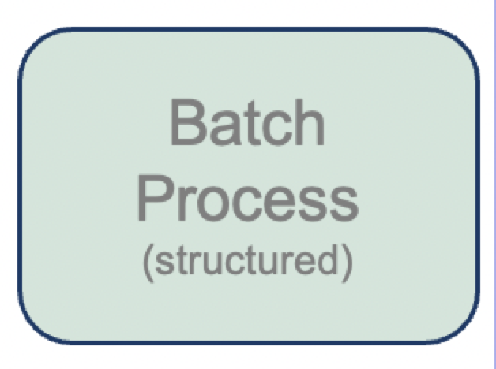
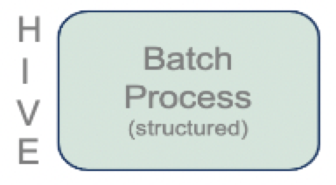
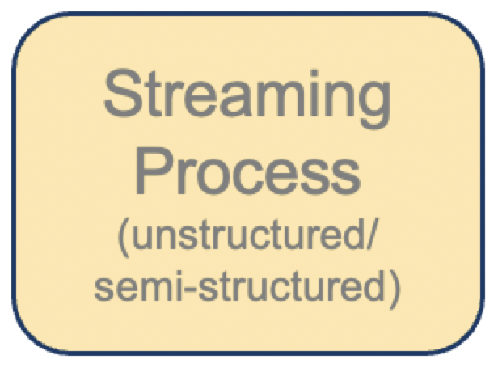
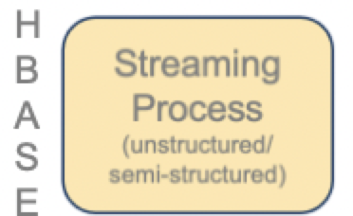
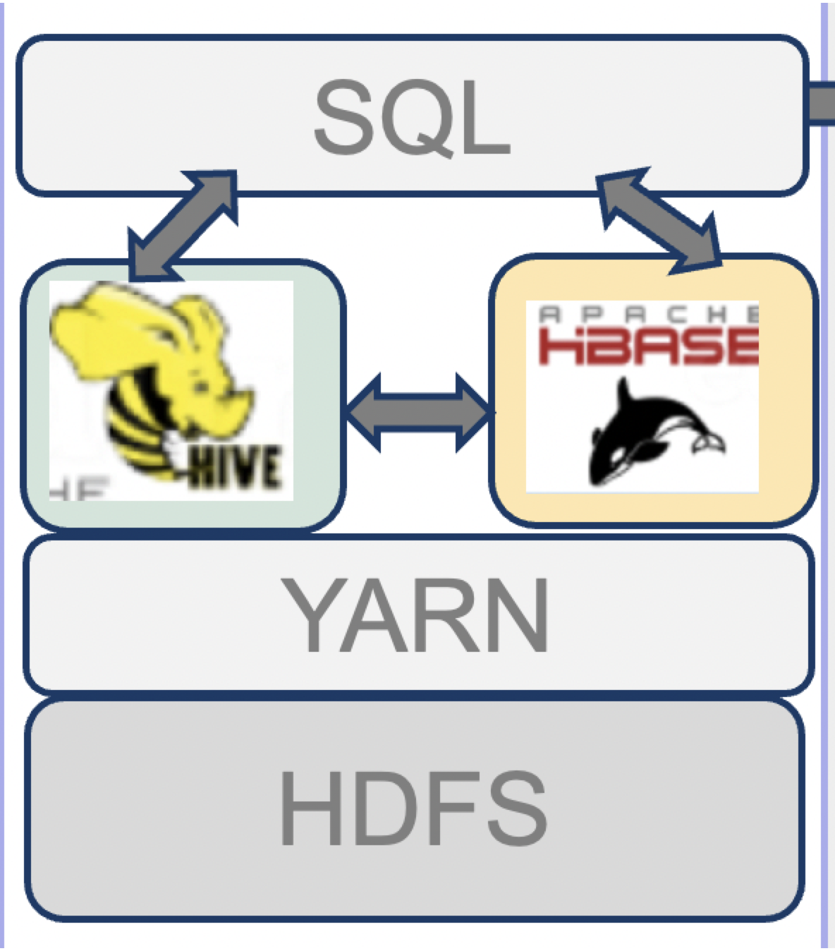
H
IVE
Storage, Retrieval, & Advanced Analysis
H
BASE
Stand-alone Storage… Better together
Hbase → → → Streaming/Real-time Data
NoSQL Storage
Large volumes unstructured/semi-structured
Real-time read/write capabilities
Hive → → → Batch Data
SQL-like queries on datasets in HDFS
Batch processing & historical data analysis
Map Reduce
HDFS → → → Raw/Long-term Data
Provides unified SQL dialect & connector Hive
Supports deep analytics and high TPS
Determines storage location based on patterns
Data in HBase automatically visible in Hive(vice-versa)
Enables sharing between online & analytical
Hive & HBase work together w/ shared transaction manager
Leverage resource isolation & workload management with YARN
to support different forms of access to data
STORAGE | batched, structured data in HDFS map reduce, executed in Hadoop ACID trans. maintain consistency | high-velocity data stored as byte arrays in cells of table cell values versioned by timestamp column-families on top of HDFS slider to deploy HBase into YARN
 | provides a single SQL dialect & connector determines where data should be stored based on usage patterns data created in HBase automatically visible in Hive & vice-versa this enables data sharing between online & analytical shared transaction manager allows Hive and HBase to work together leverage YARN to support different forms of access to data
ANALYTICS | Unified SQL Layer with Hive to support deep analytics and high TPS
RETRIEVAL with SOLR | Near real-time indexing High performance with speed & efficiency Distributed search across multiple servers Faceted Search enables refined search based on various criteria Monitor health & performance of cluster in real-time
Solr: Real-time Search & Monitoring → Quicker response times
Near real-time indexing
High performance with speed & efficiency
Distributed search across multiple servers
Faceted Search enables refined search based on various criteria
Monitor health & performance of cluster in real-time
Notes:
Discuss the importance of HDFS, Hive, HBase, and Solr in the context of storing, analyzing, and retrieving vast amounts of transactional data.
Highlight how Solr aids in real-time search and monitoring capabilities, allowing for quicker response times.
HDFS
Hive
HiveQL. Structured data in HDFS.
Batch Processing, Map Reduce, executed in Hadoop.
Optimized for complex queries and ad hoc analysis. OLAP (analytical)
ACID transactions in Hive ensure that a series of operations are treated as a single unit of work.
If any part of the transaction fails, all changes made during the transaction are rolled back, leaving the data in its original state.
Consistency : ACID transactions in Hive maintain the consistency of data.
HBase
No SQL database. Stores Un/semi structured data in column-family on top of HDFS.
Real-time processing.
Real-time queries on large data. OLTP (transaction)
Store & process real-time, high-velocity data.
There are no data types in HBase; data is stored as byte arrays in the cells of HBase table.
The content or the value in cell is versioned by the timestamp when the value is stored in the cell.
So each cell of an HBase table may contain multiple versions of data.
Solr
Powerful search platform able to handle large amounts of data & deliver fast search results.
Solr’s feature make it well-suited for implementing real-time search and monitoring capabilities where timely access to info is critical.
Newly added or modified documents are quickly searchable
Allows for fast retrieval of search results
Distributed search allows for horizontal scalability & Improved performance for handling large data
Monitoring tools help ID any issues or bottlenecks & optimize the system for better performance
Storage & Management:
combination provides single SQL dialect and single connector.
Data architects and DBAs can determine where data should be stored based on usage patterns without burdening user applications with the need to connect to multiple systems.
Data created in HBase should be automatically visible in Hive and vice-versa.
This capability renders data sharing between online and analytical completely trivial.
A shared transaction manager allows Hive’s ACID feature and multi-table HBase transactions to work together seamlessly.
Today, customers typically deploy HBase and Hive in separate clusters.
Developing a closed-loop analytics system requires effective combination of operational and analytical workloads in a multi-tenant manner.
With YARN we can effectively create a single-system by leveraging resource isolation and workload management primitives in YARN to support different forms of access to data.
Slider makes use of these when it deploys HBase into YARN, while Hive LLAP & Tez are native YARN applications, thereby simplifying the process of running a closed-loop analytical system according to a predictable SLA.

Slide 6
Solution Highlights
- Real-time fraud detection and notifications
- Sophisticated, robust, flexible, scalable, and fault-tolerant
- Handles complex data processing for streaming & batch processes
- Simplified process of running a closed-loop analytical system
Benefits of Implementation
- Real-time notifications to clients will strengthen trust
- Implementation supports enhanced compliance, ultimately reducing risk
- Consistency results in less oversight from internal & external lines of defense
- Bank and client assets are better protected
- Dynamic processes & Automation support less labor-intensive maintenance.
Benefits &
Conclusion
Notes:
Sum up the advantages of the proposed solution in mitigating fraud risks.
Reflect on how this system will enhance customer trust, ensure compliance, and protect financial assets.

